Slide 1
Designing and Analysis of Algorithm
Dr. Han Huang
South China University of Technology
1

Slide 2


Chapter 7
Space and Time Tradeoffs
Copyright © 2007 Pearson Addison-Wesley. All rights reserved.

Slide 3
Space and Time Tradeoffs
Thing which matter most must never be at the mercy of things which matter less.
------ Johann Wolfgang von Goethe (1749-1832)
Space and time tradeoffs in algorithm design are a well-known issue for both theoreticians and practitioners of computing.

Slide 4
Space-for-time Tradeoffs
Two varieties of space-for-time algorithms:
input enhancement — preprocess the input (or its part) to store some info to be used later in solving the problem
counting sorts
string searching algorithms
prestructuring — preprocess the input to make accessing its elements easier
hashing
indexing schemes (e.g., B-trees)

Slide 5
7.1 Sorting by Counting
5

Slide 6
Sorting by Counting
We discuss its application to the sorting problem.
One rather obvious idea is to count, for each element of a list to be sorted, the total number of elements smaller than this element and record the results in a table.
Thus, comparison counting sort algorithm be able to sort the list by simply copying its elements to their appropriate positions in a new, sorted list.

Slide 7
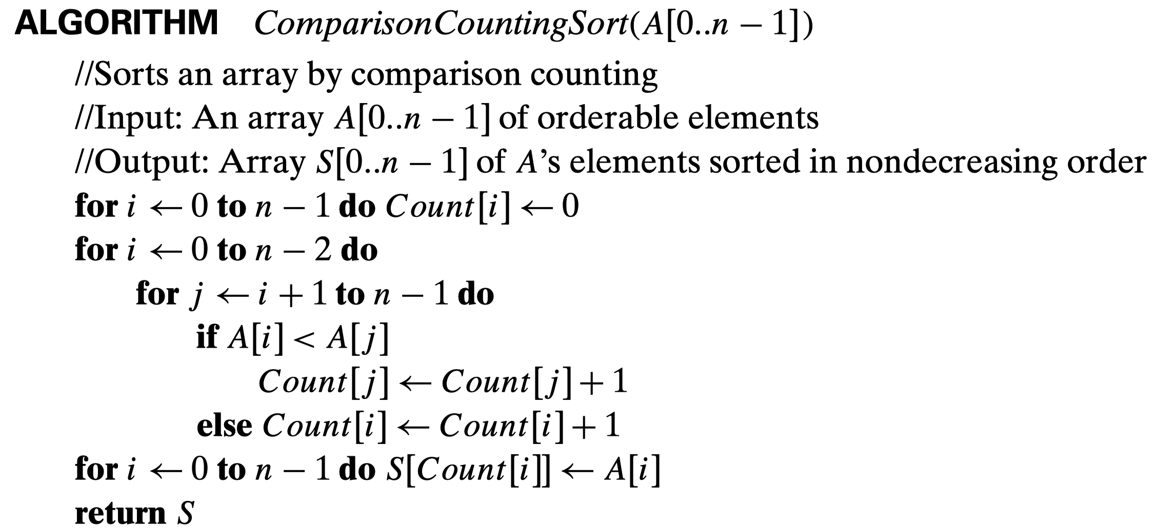
Example 1: Comparision Counting Sort
Step1:初始化计数
Step2:数组通过大小计数
Step3:通过大小计数返回排序后的数组

Slide 8
Run Time Analysis
Array A[0,…5]
Initially
After pass i = 0
i = 1
i = 2
i = 3
i = 4
Final state
Array S[0…5]
62 | 31 | 84 | 96 | 19 | 47
0 | 0 | 0 | 0 | 0 | 0
3 | 0 | 1 | 1 | 0 | 0
 | 1 | 2 | 2 | 0 | 1
 |  | 4 | 3 | 0 | 1
 |  |  | 5 | 0 | 1
 |  |  |  | 0 | 2
3 | 1 | 4 | 5 | 0 | 2
19 | 31 | 47 | 62 | 84 | 96

Slide 9
Sorting with Additional Information
But the counting idea does work productively in a situation in which elements to be sorted belong to a known small set of values.
Assume, for example, that we have to sort a list whose value can be either 1 or 2.
Rather than applying a general sorting algorithm, we should be able to take advantage of this additional information about values to be sorted.

Slide 10
Example of Distribution Counting Sort
Example consider sorting the array
whose values are known to come from the set {11,12,13} and should not be overwritten in the process of sorting.
The frequency and distribution arrays are as follows:
13 | 11 | 12 | 13 | 12 | 12
Array values | 11 | 12 | 13
Frequencies | 1 | 3 | 2
Distribution values | 1 | 4 | 6

Slide 11
Algorithm Analysis
Note that the distribution values indicate the proper positions for the last occurrences of their elements in the final sorted array.
If we index array positions from 0 to n-1, the distribution values must be reduced by 1 to get corresponding element positions.
It is more convenient to process the input array right to left.

Slide 12
Algorithm Analysis
The last element is 12, and, since its distribution value is 4, we place this 12 in position 4-1 = 3 of the array S that hold the sorted list. Then we decrease the 12’s distribution value by 1 and proceed to the next element in the given array.
A[5]= 12
A[4]= 12
A[3]= 13
A[2]= 12
A[1]= 11
A[0]= 13
1 | 4 | 6
1 | 3 | 6
1 | 2 | 6
1 | 2 | 5
1 | 1 | 5
0 | 1 | 5
 |  |  | 12
 |  | 12
 |  |  |  |  | 13
 | 12
11
 |  |  |  | 13

Slide 13
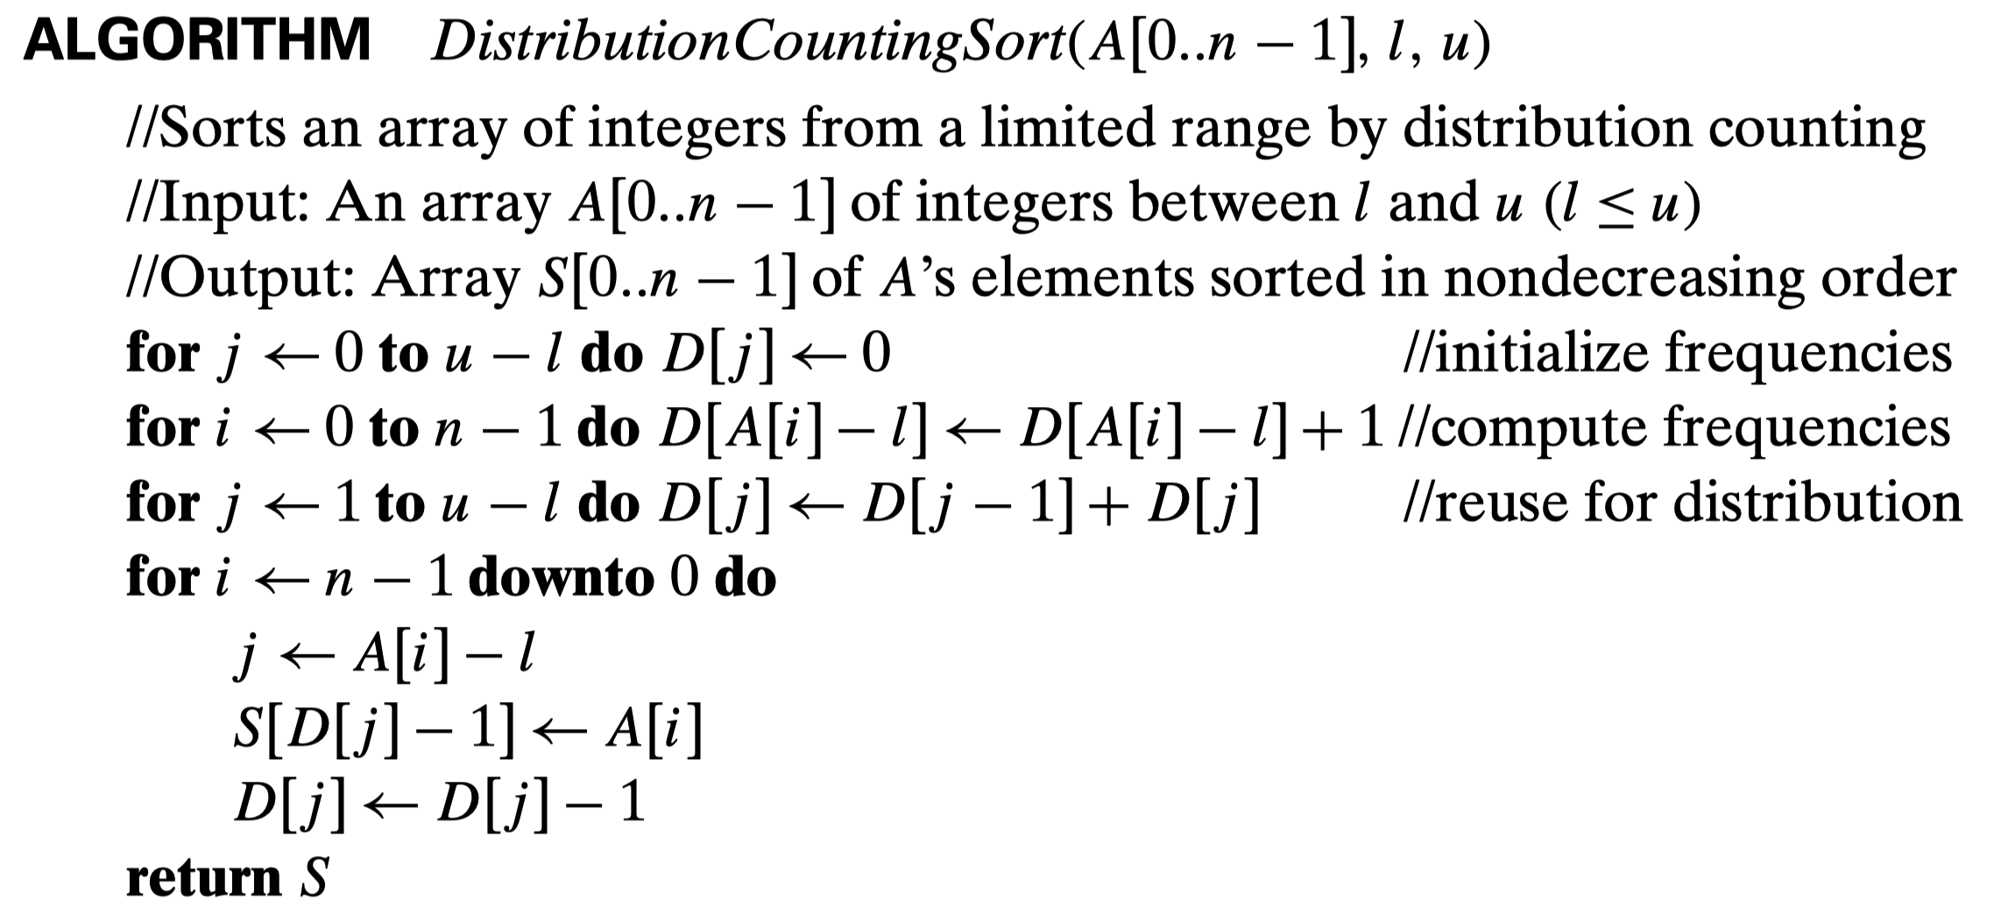
Example 2: Distribution Counting Sort
将A中该元素放到排序后数组S中指定的位置
将D中该元素-1，方便存放下一个同样大小的元素:相同的元素依次排在后面
可节省的多余算力：
得到frequencies后，单次遍历即可完成数组的排序。
时间复杂度O(n+k),其中n为要排序的数的个数，k为要排序的数的组大值。

Slide 14
Time Efficiency Analysis
Assuming that the range of array values is fixed, this is obviously a linear algorithm because it makes just two consecutive passes through its input array A.
This is a better time-efficiency class than that of the most efficient sorting algorithms – mergesort, quicksort, and heapsort – we have encountered.

Slide 15
7.2 Input Enhancement in String Matching
15

Slide 16
Review: String Searching by Brute Force
pattern: a string of m characters to search for
text: a (long) string of n characters to search in
Brute force algorithm
Step 1 Align pattern at beginning of text
Step 2 Moving from left to right, compare each character of pattern to the corresponding character in text until either all characters are found to match (successful search) or a mismatch is detected
Step 3 While a mismatch is detected and the text is not yet exhausted, realign pattern one position to the right and repeat Step 2

Slide 17
String Searching by Preprocessing
Several string searching algorithms are based on the input enhancement idea of preprocessing the pattern
Knuth-Morris-Pratt (KMP) algorithm preprocesses pattern left to right to get useful information for later searching
Boyer -Moore algorithm preprocesses pattern right to left and store information into two tables
Horspool’s algorithm simplifies the Boyer-Moore algorithm by using just one table

Slide 18
Horspool’s Algorithm
A simplified version of Boyer-Moore algorithm:
preprocesses pattern to generate a shift table that determines how much to shift the pattern when a mismatch occurs
always makes a shift based on the text’s character c aligned with the last character in the pattern according to the shift table’s entry for c

Slide 19
How Far to Shift?
Look at first (rightmost) character in text that was compared:
The character is not in the pattern
.....c...................... (c not in pattern)
BAOBAB
The character is in the pattern (but not the rightmost)
.....O...................... (O occurs once in pattern) BAOBAB
.....A...................... (A occurs twice in pattern)
BAOBAB
The rightmost characters do match
.....B......................
BAOBAB

Slide 20
Shift Table
Shift sizes can be precomputed by the formula distance from c’s rightmost ccurrence in pattern among its first m-1 characters to its right end
t(c) = pattern’s length m, otherwise
by scanning pattern before search begins and stored in a table called shift table
Shift table is indexed by text and pattern alphabet Eg, for BAOBAB:
A B C D E F G H I J K L M N O P Q R S T U V W X Y Z
1 2 6 6 6 6 6 6 6 6 6 6 6 6 3 6 6 6 6 6 6 6 6 6 6 6

Slide 21
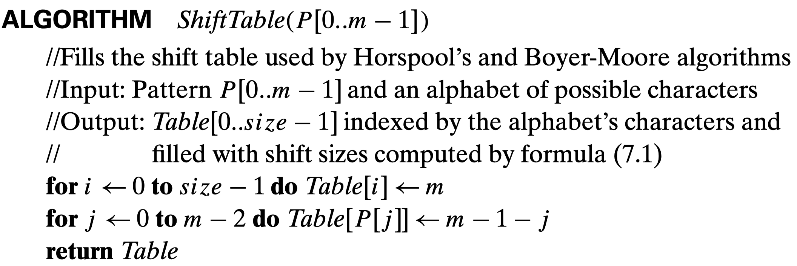
Example 1: Shift Table

Slide 22
Example of Horspool’s alg. application
BARD LOVED BANANAS
BAOBAB
BAOBAB
BAOBAB
BAOBAB (unsuccessful search)
A B C D E F G H I J K L M N O P Q R S T U V W X Y Z
_
1 2 6 6 6 6 6 6 6 6 6 6 6 6 3 6 6 6 6 6 6 6 6 6 6 6
6

Slide 23
Horspool’s Algorithm
Step 1. For a given pattern of length m and the alphabet used in both the pattern and text, construct the shift table as describe above.
Step 2. Align the pattern against the beginning of the text.
Step 3. Repeat the following until either a matching substring is found or the pattern reaches beyond the last character or the text.

Slide 24
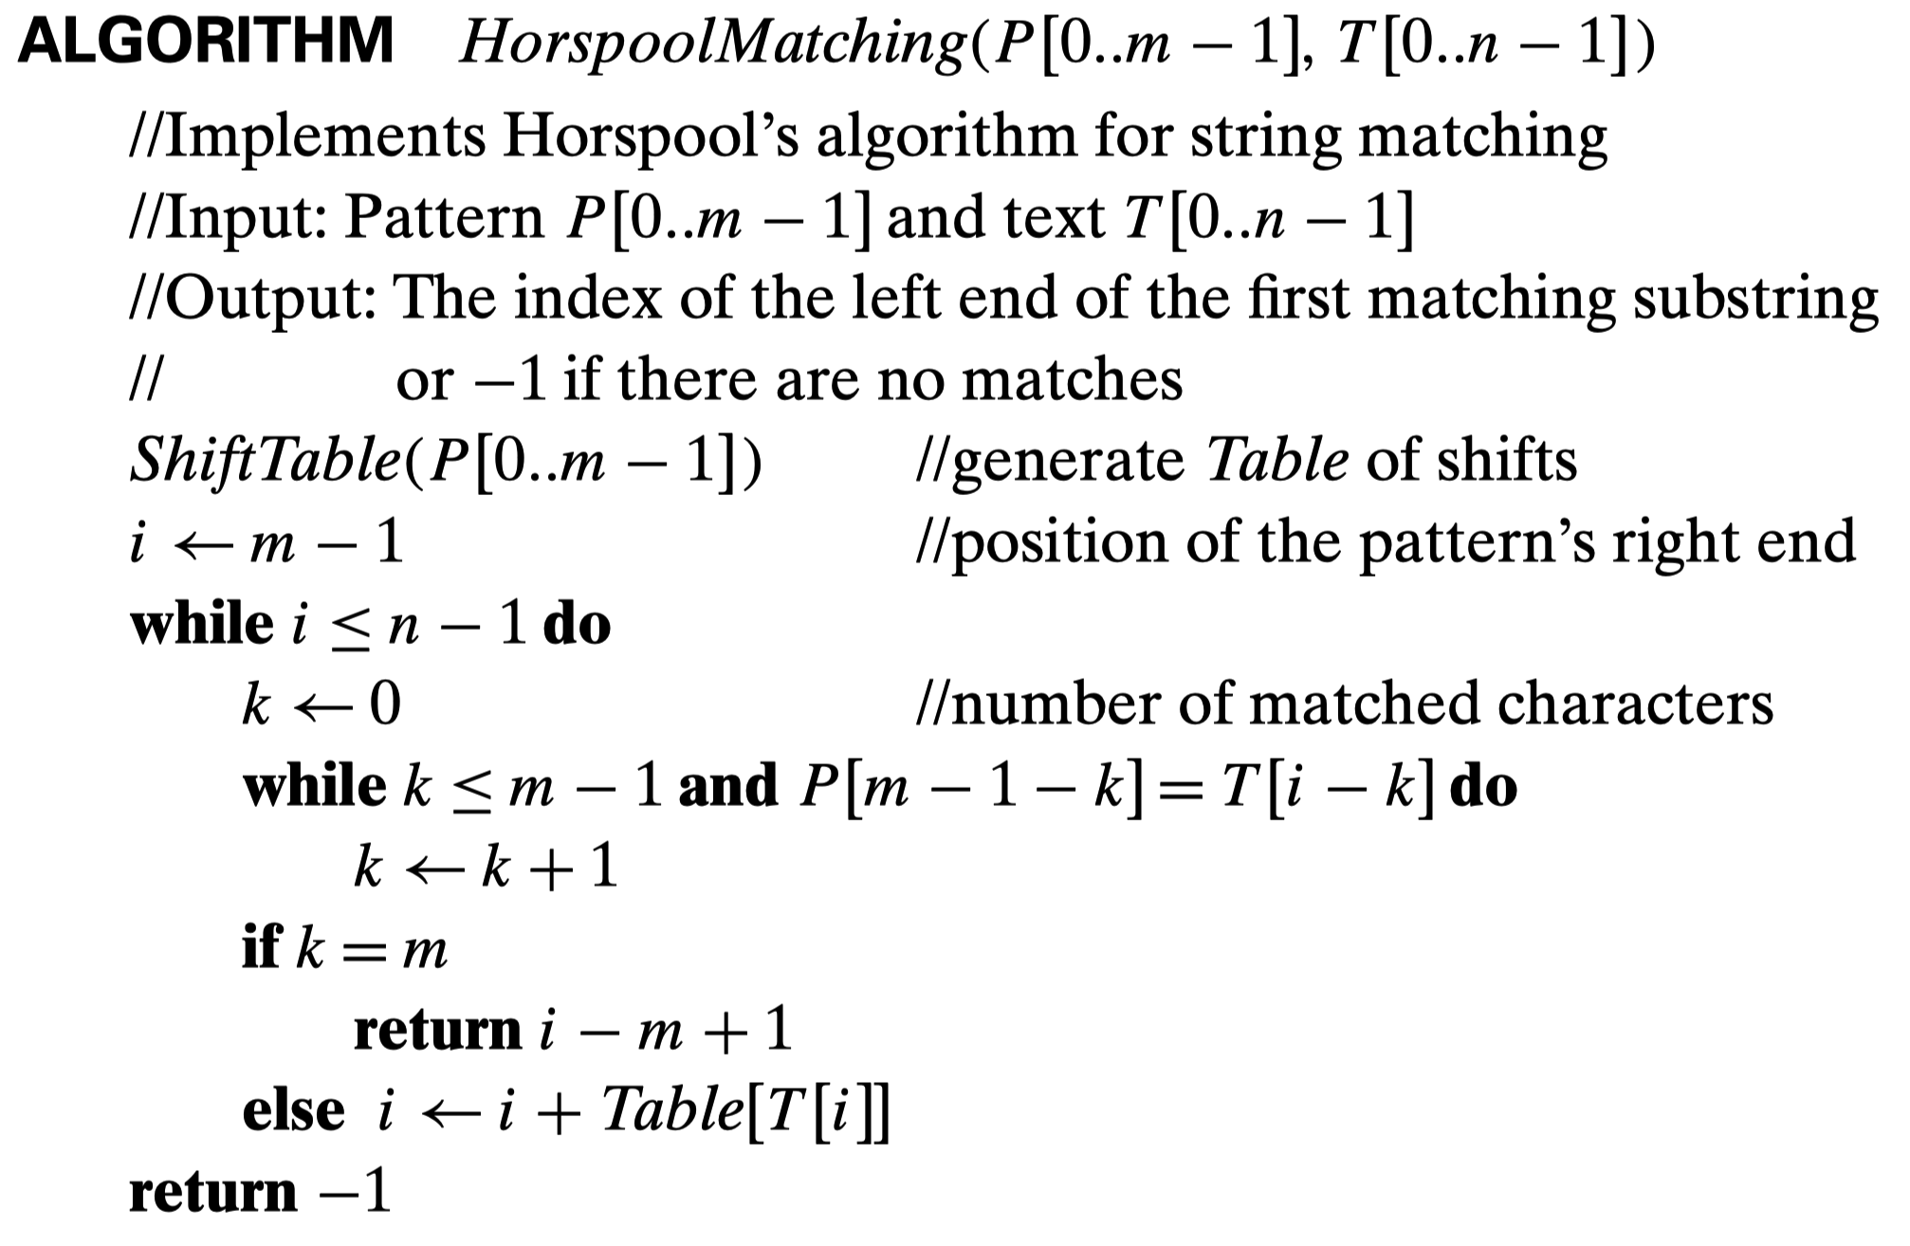
Example 2: Horspool Matching
Step1:获取转移表
Step2:初始化匹配步长k
Step3:如果匹配一位成功k自增
Step4:如果字符串完全匹配，则访问找到的匹配位置下标，否则根据转移表Table[]的内容，向后移动Table[T[i]]步继续搜索

Slide 25
Example 2: Horspool Matching
可节省的多余算力：
通过shift table得到遇到某个字符时要移动的距离，不必如蛮力法每次仅移动一步。

Slide 26
Horspool’s Algorithm Analysis
Starting with the last character in the pattern, compare the corresponding characters in the pattern and text until either all m characters are matched (then stop) or a mismatching pair is encountered.
In the latter case, retrieve the entry t(c) from the c’s column of the shift table where c is the text’ character currently aligned against the last character of the pattern, and shift the pattern by t(c) characters to the right along the text.

Slide 27
Boyer-Moore Algorithm
Based on same two ideas:
comparing pattern characters to text from right to left
precomputing shift sizes in two tables
bad-symbol table indicates how much to shift based on text’s character causing a mismatch
good-suffix table indicates how much to shift based on matched part (suffix) of the pattern

Slide 28
Bad-symbol Shift in Boyer-Moore Algorithm
If the rightmost character of the pattern doesn’t match, BM algorithm acts as Horspool’s
If the rightmost character of the pattern does match, BM compares preceding characters right to left until either all pattern’s characters match or a mismatch on text’s character c is encountered after k > 0 matches
text
pattern
bad-symbol shift d₁ = max{t₁(c ) - k, 1}
c
k matches

Slide 29
Good-suffix Shift in Boyer-Moore Algorithm
Good-suffix shift d₂ is applied after 0 < k < m last characters were matched
d₂(k) = the distance between matched suffix of size k and its rightmost occurrence in the pattern that is not preceded by the same character as the suffix Example: CABABA d₂(1) = 4
If there is no such occurrence, match the longest part of the k-character suffix with corresponding prefix; if there are no such suffix-prefix matches, d₂ (k) = m Example: WOWWOW d₂(2) = 5, d₂(3) = 3, d₂(4) = 3, d₂(5) = 3

Slide 30
Boyer-Moore Algorithm
After matching successfully 0 < k < m characters, the algorithm shifts the pattern right by d = max {d₁, d₂}
where d₁ = max{t₁(c) - k, 1} is bad-symbol shift
d₂(k) is good-suffix shift
Example: Find pattern AT_THAT in
WHICH_FINALLY_HALTS. _ _ AT_THAT

Slide 31
Boyer-Moore Algorithm (cont.)
Step 1 Fill in the bad-symbol shift table
Step 2 Fill in the good-suffix shift table
Step 3 Align the pattern against the beginning of the text
Step 4 Repeat until a matching substring is found or text ends:
Compare the corresponding characters right to left.

Slide 32
Boyer-Moore Algorithm
If no characters match, retrieve entry t₁(c) from the bad-symbol table for the text’s character c causing the mismatch and shift the pattern to the right by t₁(c).
If 0 < k < m characters are matched, retrieve entry t₁(c) from the bad-symbol table for the text’s character c causing the mismatch and entry d₂(k) from the good-suffix table and shift the pattern to the right by d = max {d₁, d₂} where d₁ = max{t₁(c) - k, 1}.

Slide 33
Example of Boyer-Moore alg. application
B E S S _ K N E W _ A B O U T _ B A O B A B S
B A O B A B
d₁ = t₁(K) = 6 B A O B A B
d₁ = t₁(_)-2 = 4
d₂(2) = 5
B A O B A B
d₁ = t₁(_)-1 = 5
d₂(1) = 2
B A O B A B (success)
A B C D E F G H I J K L M N O P Q R S T U V W X Y Z
_
1 2 6 6 6 6 6 6 6 6 6 6 6 6 3 6 6 6 6 6 6 6 6 6 6 6
6
k | pattern | d₂
1 | BAOBAB | 2
2 | BAOBAB | 5
3 | BAOBAB | 5
4 | BAOBAB | 5
5 | BAOBAB | 5
33

Slide 34
7.3 Hashing
34

Slide 35
Hashing
Hashing is based on the idea of distributing keys among a one-dimensional array H[0..m-1] called a hash table.
The distribution is done by computing, for each of the keys, the value of some predefined function h called the hash function.
This function assigns an integers between 0 and m-1, called the hash address, to a key.

Slide 36
Hashing
If keys are nonnegative integers, a hash function can be of the form h(K) = K mod m.
If keys are letters of some alphabets, we can first assign a letter its position in the alphabet and then apply the same kind of a function of a function used for integer.
Finally, if K is a character string c0c1…cs-1, we can use, as a very unsophisticated option.

Slide 37
Hashing
A very efficient method for implementing a dictionary, i.e., a set with the operations:
find
insert
delete
Based on representation-change and space-for-time tradeoff ideas
Important applications:
symbol tables
databases (extendible hashing)

Slide 38
Hash Tables and Hash Functions
The idea of hashing is to map keys of a given file of size n into a table of size m, called the hash table, by using a predefined function, called the hash function,
h: K → location (cell) in the hash table

Slide 39
Hash Table
The hash table converts the Key into an integer number through the hash function, and then the number is taken over the length of the array, and the result is used as the subscript of the array, and the value is stored in the array with the number as the subscript.
When using a hash table for querying, use the hash function to convert the key to the corresponding array subscript, and locate the space to obtain value, so that you can make full use of the positioning performance of the array for data positioning.

Slide 40
Hash Table and Functions
typedef struct //定义哈希表的结构
{int elem[MAXSIZE]; //数据元素体
HAVEORNOT elemflag[MAXSIZE]; //元素状态标志，没有记录、有记录、有过记录但已被删除
int count; //哈希表中当前元素的个数
}HashTable;
//在查找成功时删除待删元素e，并返回True，否则返回False
BOOL DeleteHash(HashTable &H,Record e)
{int &p;
if(!SearchHash(H,e.keynum,p)) //表中不存在待删元素
return False;
else{H.elemflag[p]=DELKEY; //设置标志为DELKEY，表明该元素已被删除
H.count--; //哈希表当前长度减一
return True;}}
//在开放定址哈希表H中查找关键字为k的数据元素，若查找成功，以p指示，待查数据元素在表中的位置，并返回True；否则，以p指示插入位置，并返回False
BOOL SearchHash(HashTable H,int k,int &p)
{int &p1;
p1=p=Hash(k); //求得哈希地址
while(H.elemflag[p]==HAVEKEY&&k!=H.elem[p])
//该位置中填有记录并且关键字不相等
{p++; //冲突处理方法：线性探测再散列
if(p>=MAXSIZE) p=p%MAXSIZE; //循环搜索
if(p==p1) return False; //整个表已搜索完，没有找到待查元素
}
if(k==H.elem[p]&&H.elemflag[p]==HAVEKEY) //查找成功，p指示待查元素位置
return True;
else return False; //查找不成功
}

Slide 41
Example of Hash Table and Functions
Example: student records, key = SSN. Hash function:
h(K) = K mod m where m is some integer (typically, prime)
If m = 1000, where is record with SSN= 314159265 stored?
Generally, a hash function should:
be easy to compute
distribute keys about evenly throughout the hash table

Slide 42
Requirement of Hash Function
A hash function needs to distribute keys among the cells of the hash table as every as possible.
(Because of this requirement, the value of m is usually chosen to be prime. The requirement also makes it desirable, for most applications, to have a hash function dependent on all bits of a key, not just some of them)
A hash function has to be easy to compute.

Slide 43
Collisions
If h(K₁) = h(K₂), there is a collision
Good hash functions result in fewer collisions but some collisions should be expected (birthday paradox)
Two principal hashing schemes handle collisions differently:
Open hashing – each cell is a header of linked list of all keys hashed to it
Closed hashing
one key per cell in case of collision, finds another cell by
linear probing: use next free bucket
double hashing: use second hash function to compute increment

Slide 44
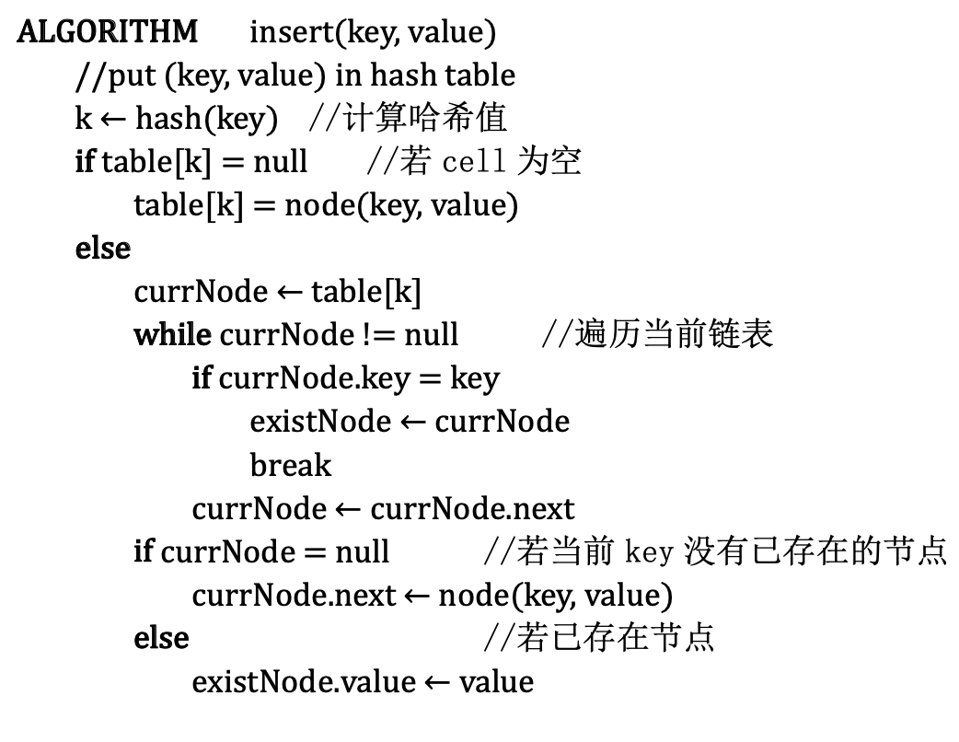
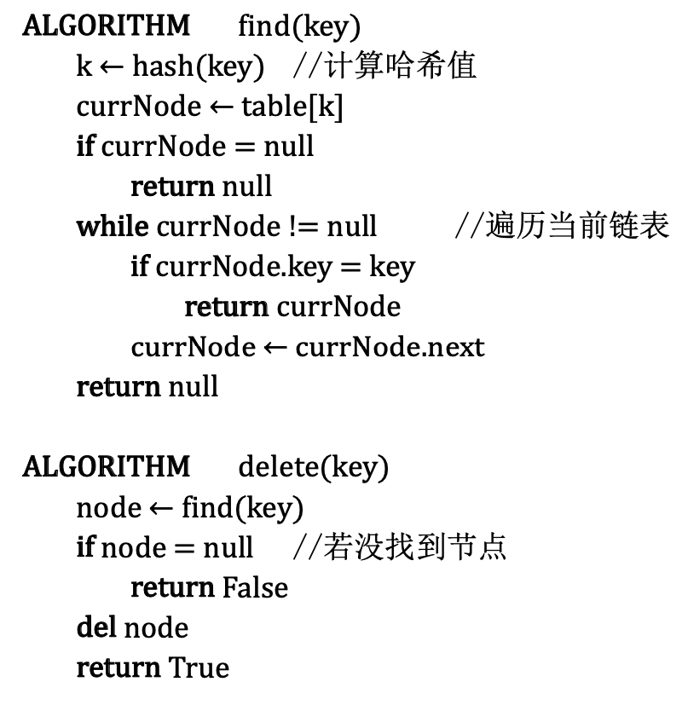
Open Hashing(Pseudocode)

Slide 45
Open Hashing (Separate Chaining)
Keys are stored in linked lists outside a hash table whose elements serve as the lists’ headers.
Example: A, FOOL, AND, HIS, MONEY, ARE, SOON, PARTED
h(K) = sum of K ‘s letters’ positions in the alphabet MOD 13
Key | A | FOOL | AND | HIS | MONEY | ARE | SOON | PARTED
h(K) | 1 | 9 | 6 | 10 | 7 | 11 | 11 | 12
0
1
2
3
4
5
6
7
8
9
10
11
12
A
AND
MONEY
FOOL
HIS
ARE
PARTED
SOON
Search for KID

Slide 46
Open Hashing (cont.)
If hash function distributes keys uniformly, average length of linked list will be α = n/m. This ratio is called load factor.
Average number of probes in successful, S, and unsuccessful searches, U:
S ≈ 1+α/2, U = α
Load α is typically kept small (ideally, about 1)
Open hashing still works if n > m

Slide 47
Closed Hashing (Open Addressing)
Keys are stored inside a hash table.
Key | A | FOOL | AND | HIS | MONEY | ARE | SOON | PARTED
h(K) | 1 | 9 | 6 | 10 | 7 | 11 | 11 | 12
0
1
2
3
4
5
6
7
8
9
10
11
12
 | A
 | A |  |  |  |  |  |  |  | FOOL
 | A |  |  |  |  | AND |  |  | FOOL
 | A |  |  |  |  | AND |  |  | FOOL | HIS
 | A |  |  |  |  | AND | MONEY |  | FOOL | HIS
 | A |  |  |  |  | AND | MONEY |  | FOOL | HIS | ARE
 | A |  |  |  |  | AND | MONEY |  | FOOL | HIS | ARE | SOON
PARTED | A |  |  |  |  | AND | MONEY |  | FOOL | HIS | ARE | SOON

Slide 48
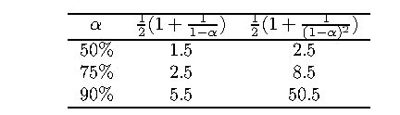
Closed Hashing (cont.)
Does not work if n > m
Avoids pointers
Deletions are not straightforward
Number of probes to find/insert/delete a key depends on load factor α = n/m (hash table density) and collision resolution strategy. For linear probing: S = (½) (1+ 1/(1- α)) and U = (½) (1+ 1/(1- α)²)
As the table gets filled (α approaches 1), number of probes in linear probing increases dramatically:

Slide 49
7.4 B-Trees
49

Slide 50
B-Trees
The idea of using extra space to facilitate faster access to a given data set is particularly important if the data set in question contains a very large number of records that need to be stored on a disk.
A principal device in organizing such data sets in an index, which provides some information about the location of records with indicated key values.

Slide 51
B-Trees
For data sets of structured records, the most important index organization is the B-tree, introduced by R. Bayer and E. McGreight.
It extends the idea of the 2-3 tree by permitting more than a single key in the same node of a search tree.
In the B-tree version we consider here, all data records are stored at the leaves, in increasing order of the keys.

Slide 52
Parental Node of B-tree
P0
K1
P1
…
Pi-1
Ki
Pi
Pn-2
Kn-1
Pn-1
T0
T1
Ti-1
Ti
Tn-2
Tn-1

Slide 53
Example of a B-tree of Order 4
20
51
10
14
24
28
38
55
80
4,
7,
10
11,
14
15,
16,
19
20,
24
25,
28
34,
38
40,
43,
46
51,
55
60,
68,
80

Slide 54
Analysis of B-tree
The root is either a leaf or has between 2 and m children.
Each node, except for the root and the leaves, has between [m/2] and m children (and hence between [m/2]-1 and m-1 keys)
The tree is (perfectly) balanced; i.e., all its leaves are at the same level.

Slide 55
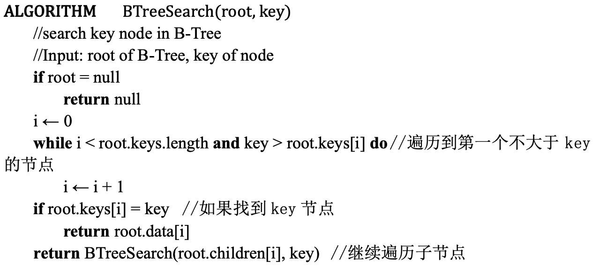
B-tree’s Pseudocode

Slide 56
For any B-tree of order m with n height h>0
Order m | 50 | 100 | 250
h’s upper bound | 6 | 5 | 4

Slide 57
B-tree obtained after inserting 65 into B-tree
20
51
11
15
25
34
40
60
68
4,
7,
10
11,
14
15,
16,
19
20,
24
25,
28
34,
38
40,
43,
46
51,
55
60,
65
68,
80

Slide 58
7.5 Application
58

Slide 59

Spam filters - Application of string matching algorithms
Spam filters use a string matching algorithm to drop spam. For example, to classify an email message as spam or no longer classified as spam, a string matching algorithm allows you to mark messages that contain keywords as spam by searching the content of the email for possible spam keywords.
59

Slide 60
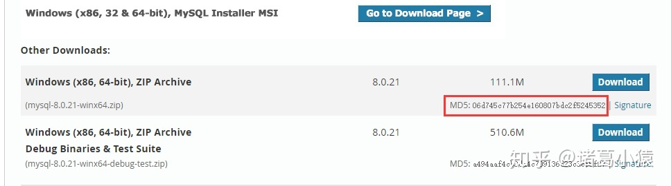
Secure encryption - Application of hash algorithm
It is important to use a symbol to represent something unique in network transmissions. when downloading a file, the file will go through many network servers and routers during the download process, and the hash algorithm is used in practical applications to generate encrypted ciphertext(加密密文) to ensure that there is no packet loss during the download process of this file and is completely downloaded.
60

Slide 61
Secure encryption - Application of hash algorithm
For example, when downloading mySQL from the mysql official website, in the lower right corner of the package, there will be a hash value calculated by the MD5 algorithm. Use the hash value to verify whether the downloaded package is complete.
61

Slide 62
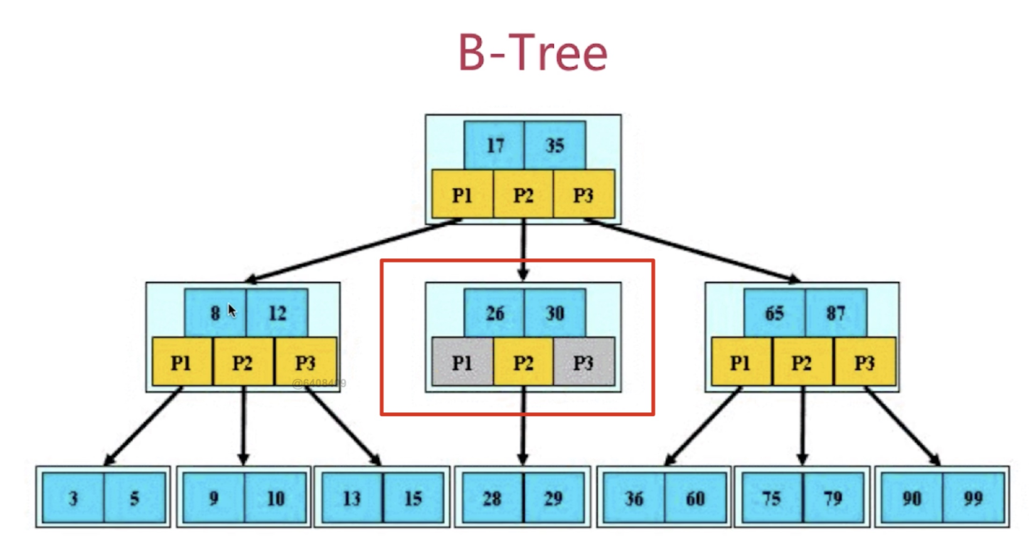
File index - Application of B-tree
Advantage:
B-tree is a tree structure, which can store index information according to ordered rules when saving.
Tree structure Each node can store multiple keywords, that is, multiple indexes, so an I/O knows as much as possible where to go next and whether an index is currently hit.
62

Slide 63
7.6 Exercise
63

Slide 64
Exercise
Please complete the following code
ALGORITHM DistributionCounting(A[0..n-1],l,u)
//Sorts an array of integers from a limited range by distribution counting
//Input: An array A[0..n-1] of integers between l and u(l≤u)
//Output: Array S[0..n-1] of A’s elements sorted in nondecreasing order
for i ← 0 to u-l do D[i] ← 0 // initialize freguencies
for j ← 0 to n-1 do ①_______________ //compute freguencies
for i ← 1 to u-l do ②_______________ //reuse for distribution
for j ← n-1 downto 0 do
i ← ③_______________
S[D[i]-1] ← ④_______________
D[i] ← ⑤_______________
return S

Slide 65
Exercise
Please complete the following code
ALGORITHM DistributionCounting(A[0..n-1],l,u)
//Sorts an array of integers from a limited range by distribution counting
//Input: An array A[0..n-1] of integers between l and u(l≤u)
//Output: Array S[0..n-1] of A’s elements sorted in nondecreasing order
for i ← 0 to u-l do D[i] ← 0 // initialize freguencies
for j ← 0 to n-1 do _ D[A[i] − l] ← D[A[i] − l] + 1 __ //compute freguencies
for i ← 1 to u-l do __ D[j] ← D[j − 1] + D[j] ____ //reuse for distribution
for j ← n-1 downto 0 do
i ← ___ A[i] − l________
S[D[i]-1] ← ____ A[i] ___________
D[i] ← ____ D[j] − 1 ___________
return S

Slide 66
End of the Section 7
Click to edit company slogan .
66

